Slide 1

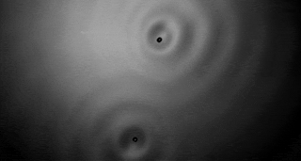
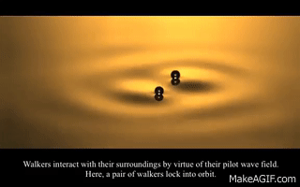
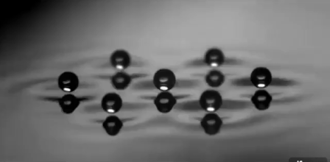
Bouncing
Walking
Orbiting
Crystals

Slide 2
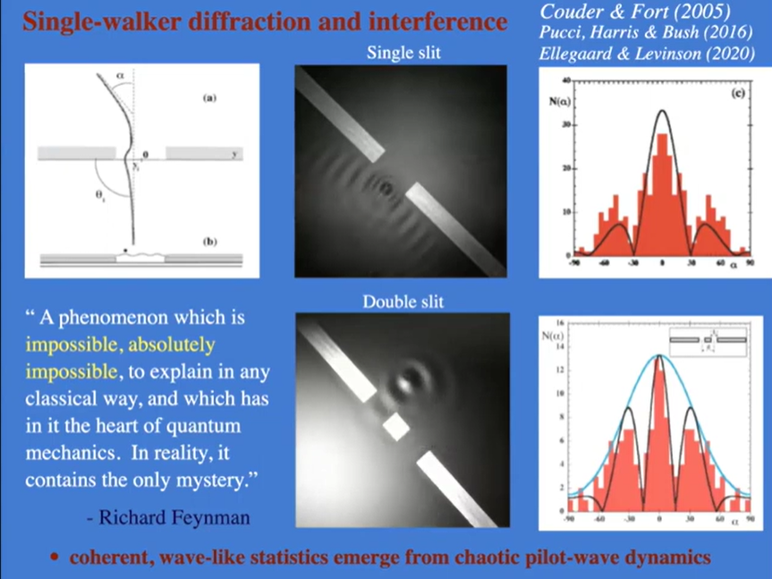
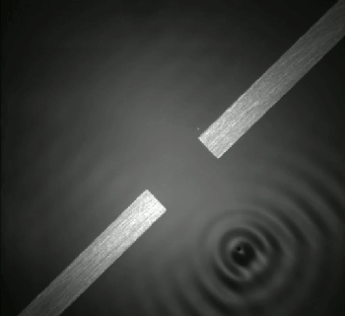
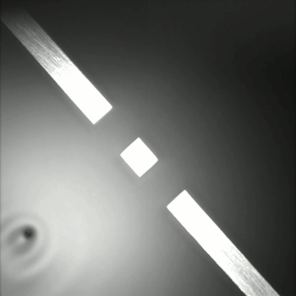

Slide 3
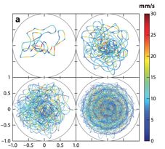
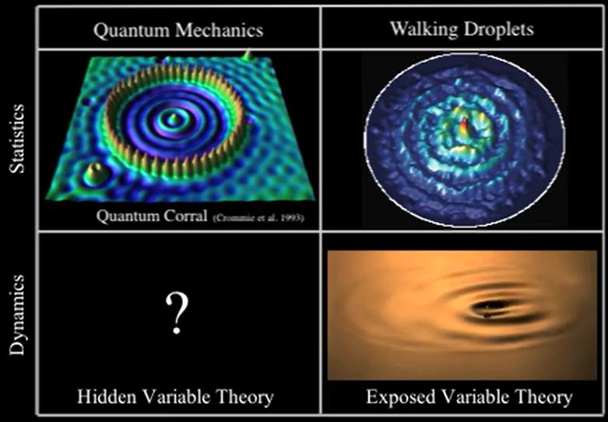
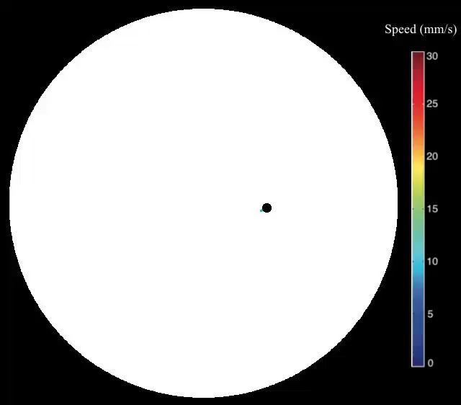
Particle in a well
Harris, Couder & Bush et al, Physical Review E 88 11001 (2013)

Slide 4
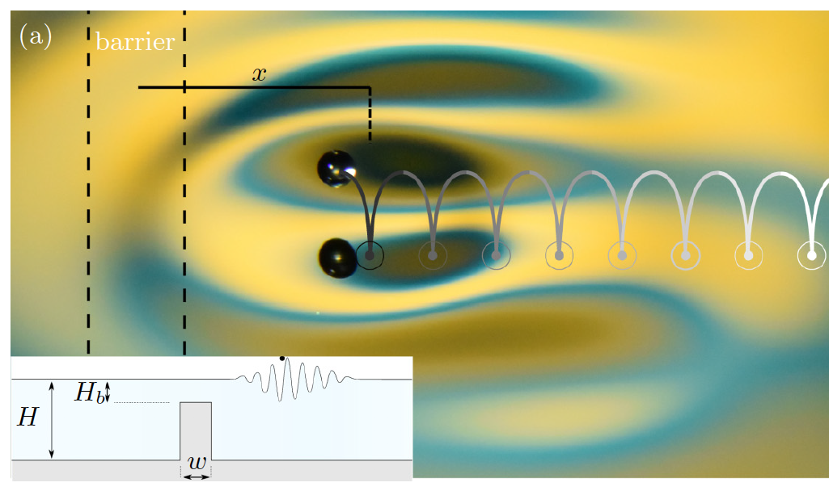
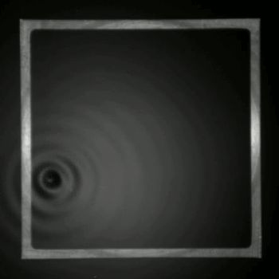
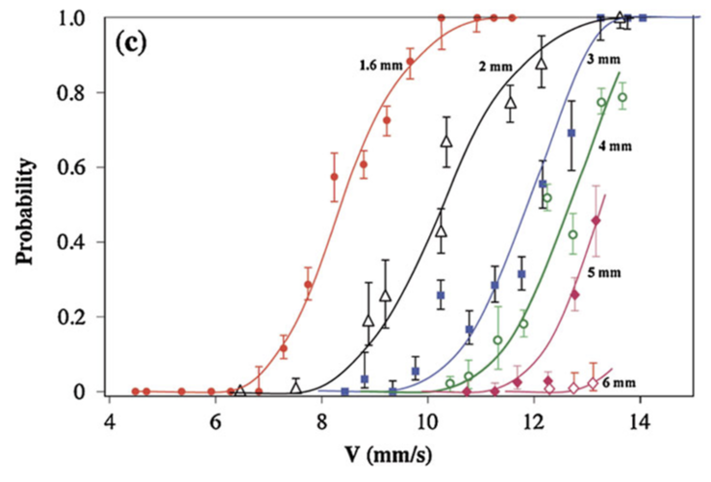
Tunneling
Unpredictable tunneling of walking droplets decreases exponentially with barrier width—as in quantum tunneling
Eddi, Fort, Moisy & Couder, Physical Review Letters 102 240401 (2009)

Slide 5
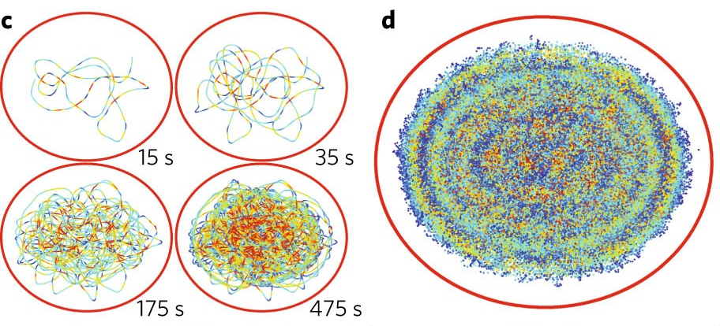
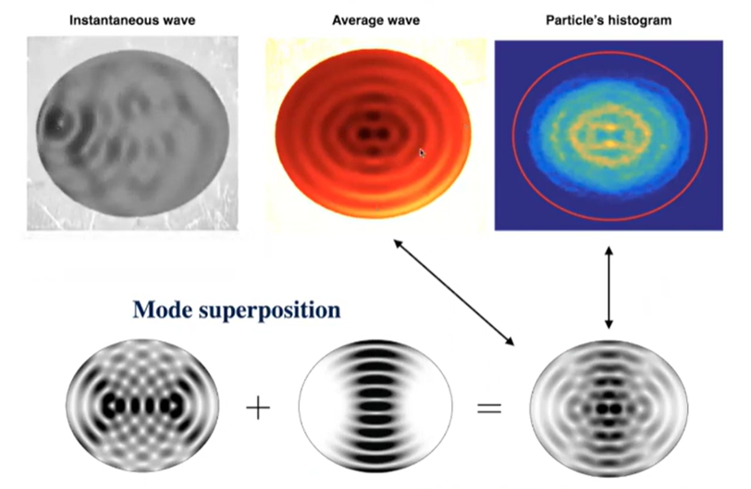
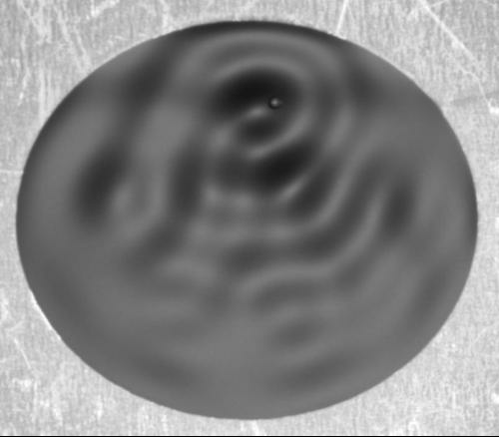
Superposition
Saenz, Cristea-Platon & Bush, Nature Physics 14 315 (2018)

Slide 6
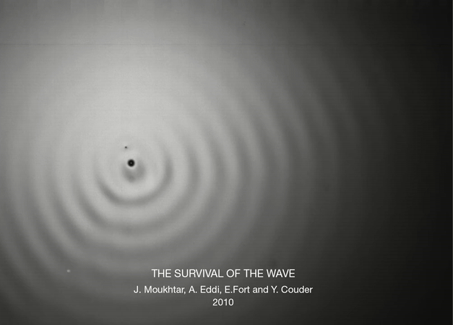
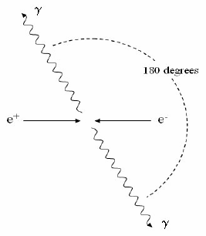
Particle-void annihilation
Annihilation of a walking droplet and a bubble. Surviving wavefield carries the droplets path memory
Eddi & Couder et al, J Fluid Mech 674 433 (2011)

Slide 7
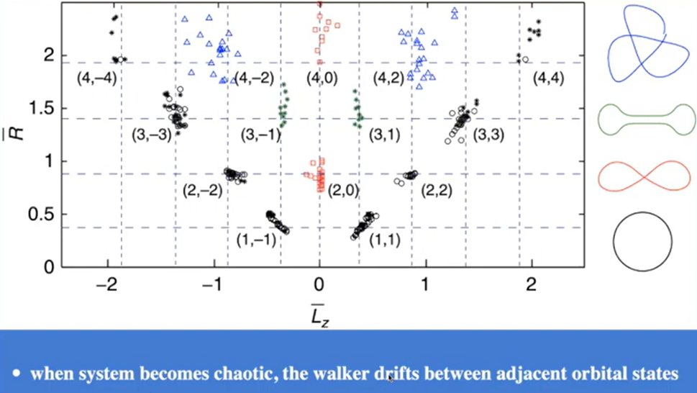
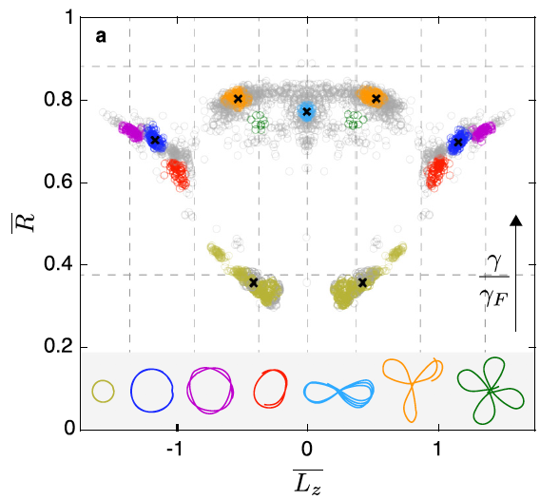
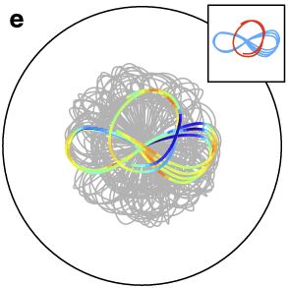
Quantized orbits
Attractive orbits for a droplet in a corral
Attractive orbits for a magnetized droplet interacting with a point-like magnetic potential
Perrard, Fort & Couder et al, Nature Comm 5 3219 (2014)
Cristea-Platon, Saenz & Bush, Chaos 28 96116 (2018)

Slide 8
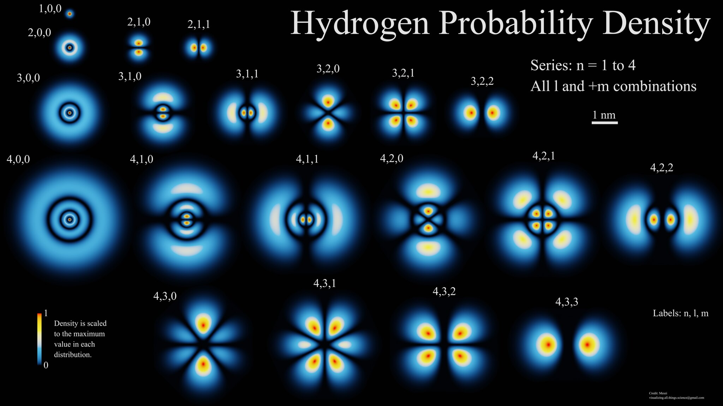

Slide 9
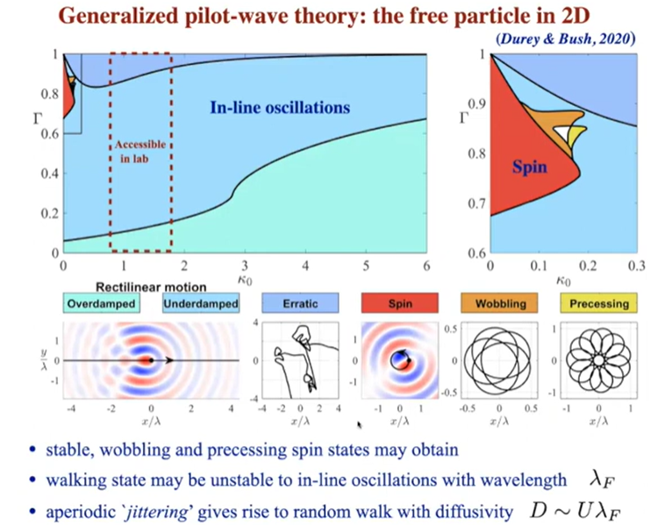

Slide 10
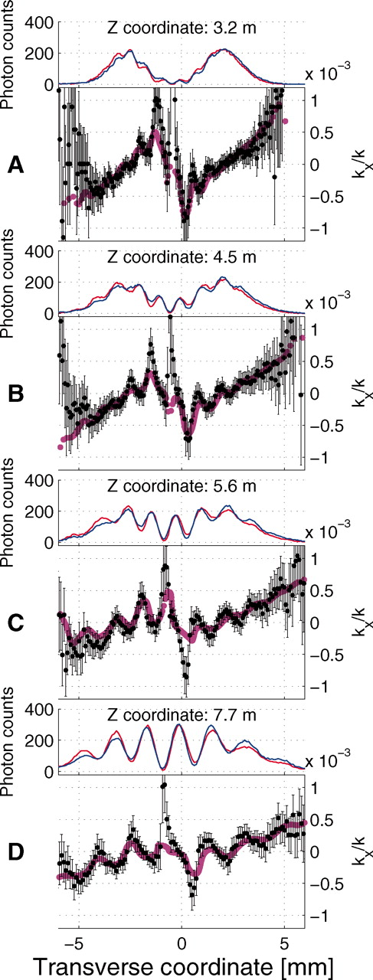
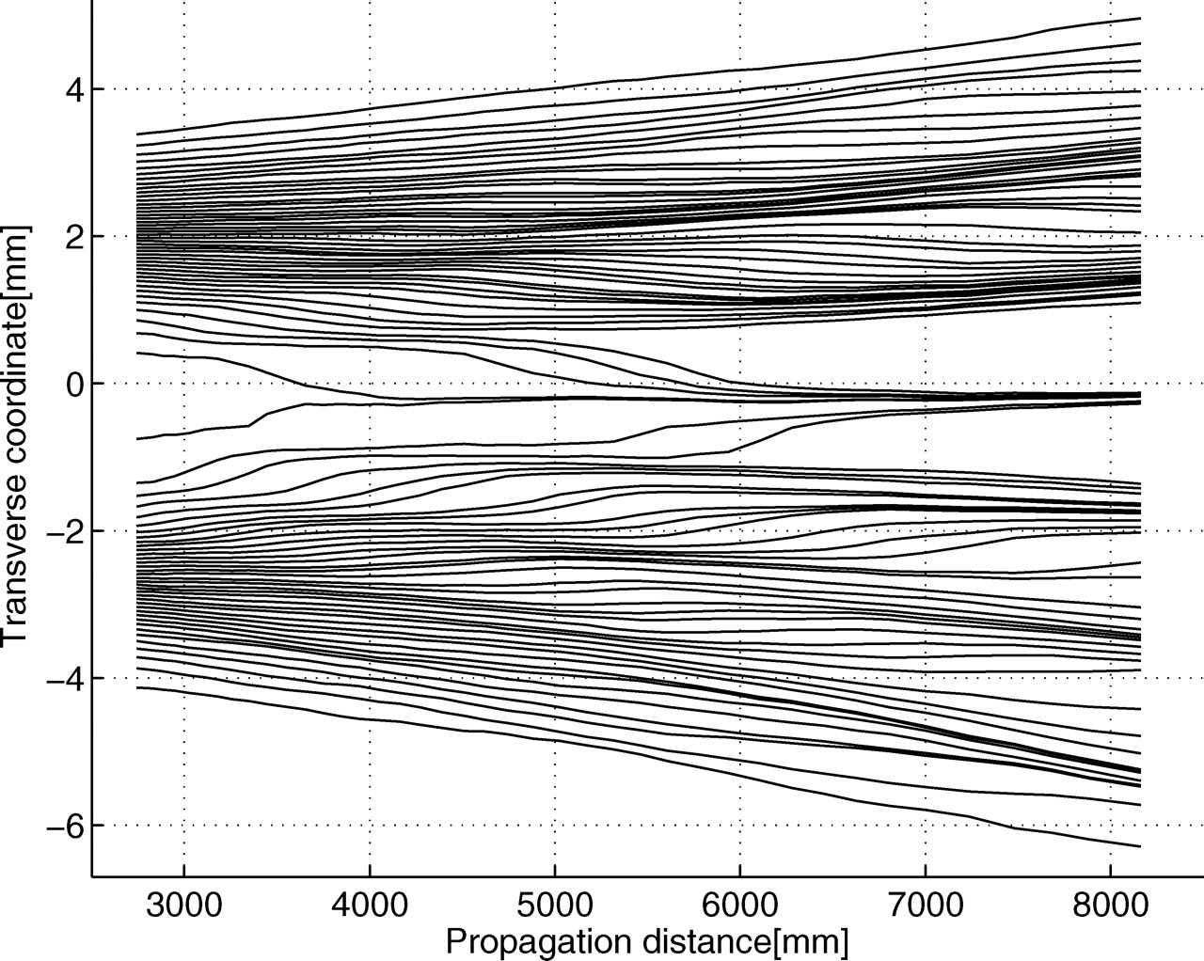
Observed photon trajectories
While an individual particle’s trajectory cannot be traced, weak measurements over many identically prepared states can yield average trajectories
“One can ascertain the mean momentum of the subensemble of particles that arrive at any given position, and, by thus determining the momentum at many positions in a series of planes, one can experimentally reconstruct a set of average trajectories. We use a modified version of this protocol to reconstruct the “weak-valued trajectories” followed by single photons as they undergo two-slit interference. In the case of single-particle quantum mechanics, the trajectories measured in this fashion reproduce those predicted in the Bohm–de Broglie interpretation of quantum mechanics.”
Kocsis & Steinberg et al, Science 332 1170 (2011)

